Slide 1

Can we call you?
TEAM FOURWARD FORCE
Dharshini Bala Soundararaj
Premi Jawahar Vasagam
Prriyamvradha Parthasarathi
Sofia Rajan

Slide 2
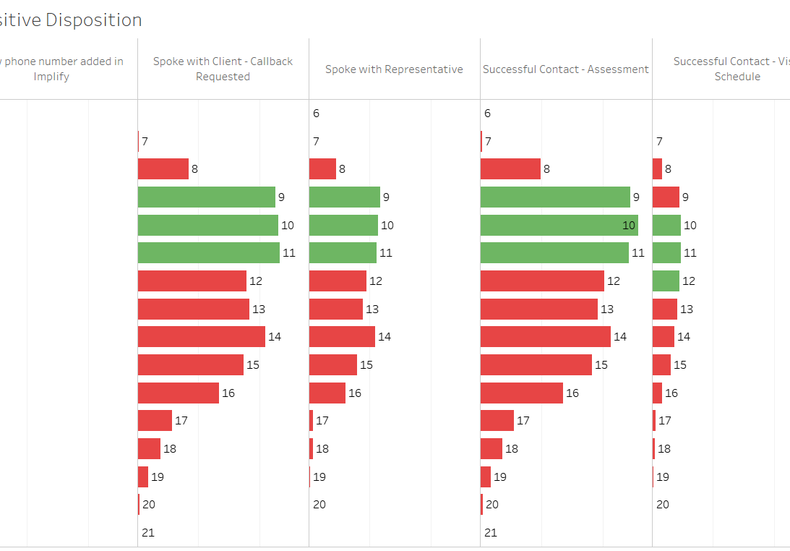
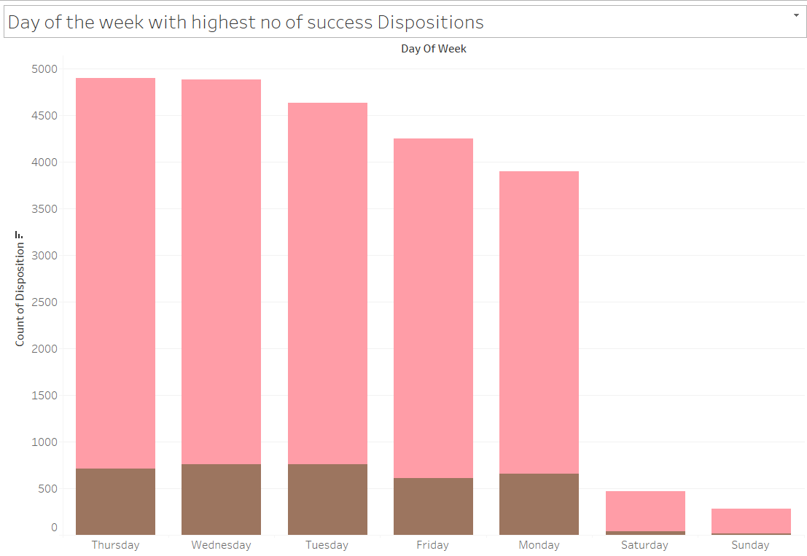
Is there a better time to call you?
Top 3 Hours with Positive Disposition
Converted UTC Time Zone to Local Time Zone (CST/CDT, PST/PDT, EST/EDT, MST/MDT)
Identified 9 AM, 10 AM, and 11 AM as the hours of the day with the highest probability of positive disposition rates.
Thursday has the highest probability of successful disposition
Notes:
This slide makes a prediction based on the historic data that’s available to us. We are visualizing that contacting individuals during this time frame has a better chance of doing the lead conversion.

Slide 3
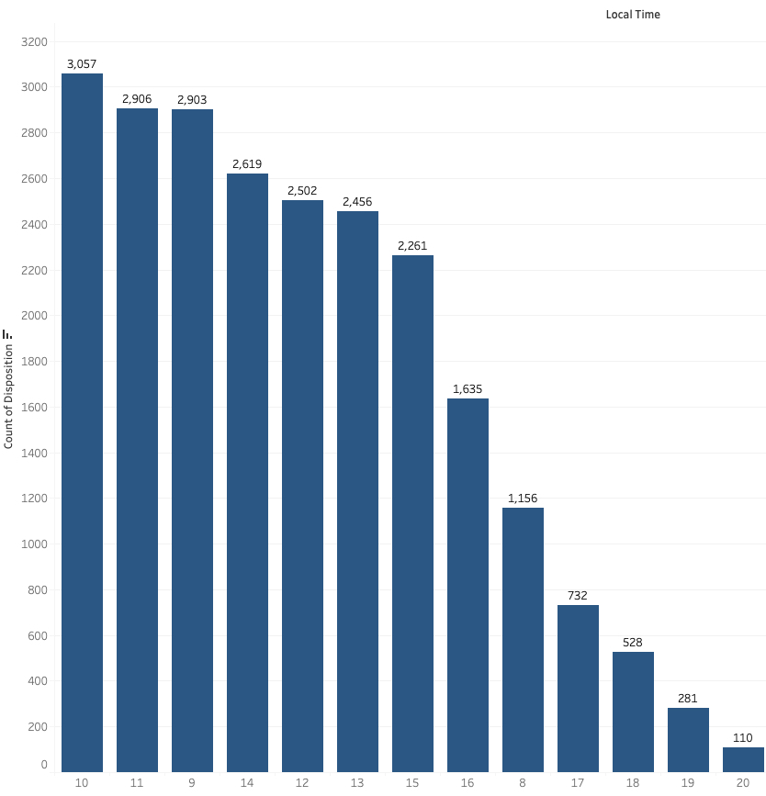
What’s the best time to make a call?
The overall top 3 hours with highest successful disposition rates are 10AM, 11AM, 9AM, 2PM, and 12PM
During the start of the day, most people tend to be active in attending the calls rather than later part of the Day.
Notes:
Does age group have a correlation to what time they are being contacted in making a lead conversion? Lets say that we identify a trend where older people are more likely listen and accept MCO if we contact them during the business hours whereas people of working age preferred to be contacted outside of their work hours, lets say 5pm to 7pm. It may be because older people may sleep early into the night and they don’t prefer talking on the phones later in the evening, we can also say that the culture here is to have early dinner which means 6pm is the latest that they would be available for a talk. Also, the mid aged people can also be parents of children from our dataset. So its essential that bucket ages until 18 into a bucket and interpret them on this scenario.

Slide 4
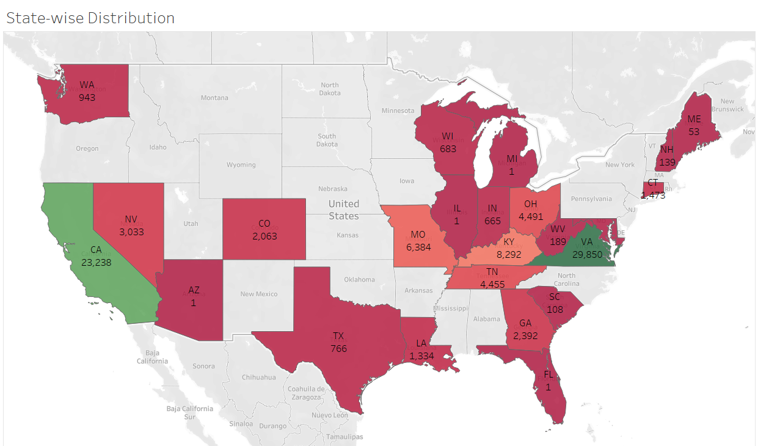
State wise distribution of call dispositions
CA and VA have high successful dispositions whereas AZ, IL, MI, FL are very low. Let’s say that individuals from California or NY are more likely to accept care because of the high cost of living there. This is just an example, but based on the visualization we can make assumption on why individuals from a particular state have more chances of accepting MCO.
Notes:
are YOU most likely to accept our care?

Slide 5
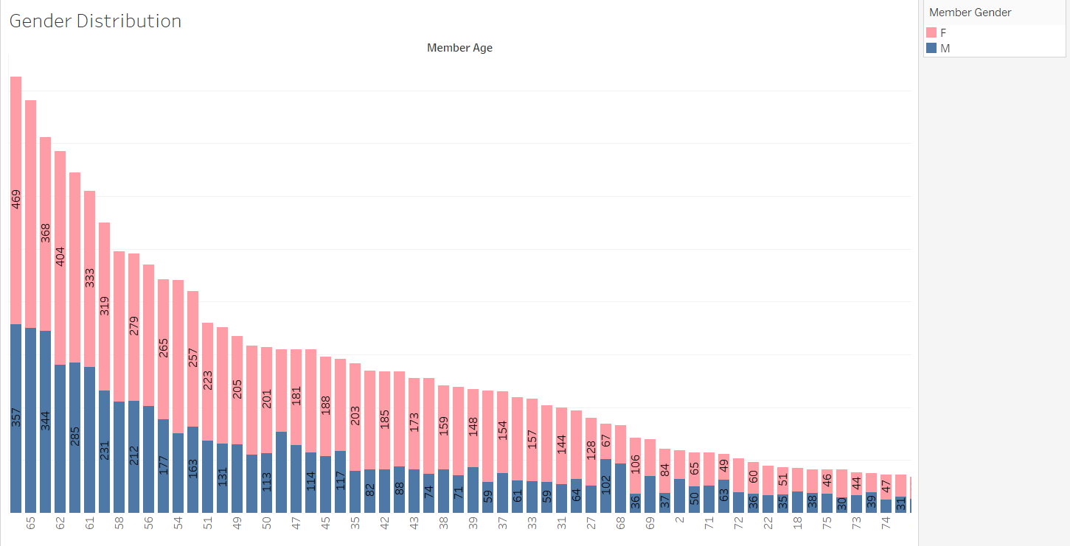
Does Gender play a role in a successful call?
We observed that more females were successful contacts since they scheduled appointments and visits compared to males
We can target our calls towards the females since they have higher chances of accepting the care

Slide 6
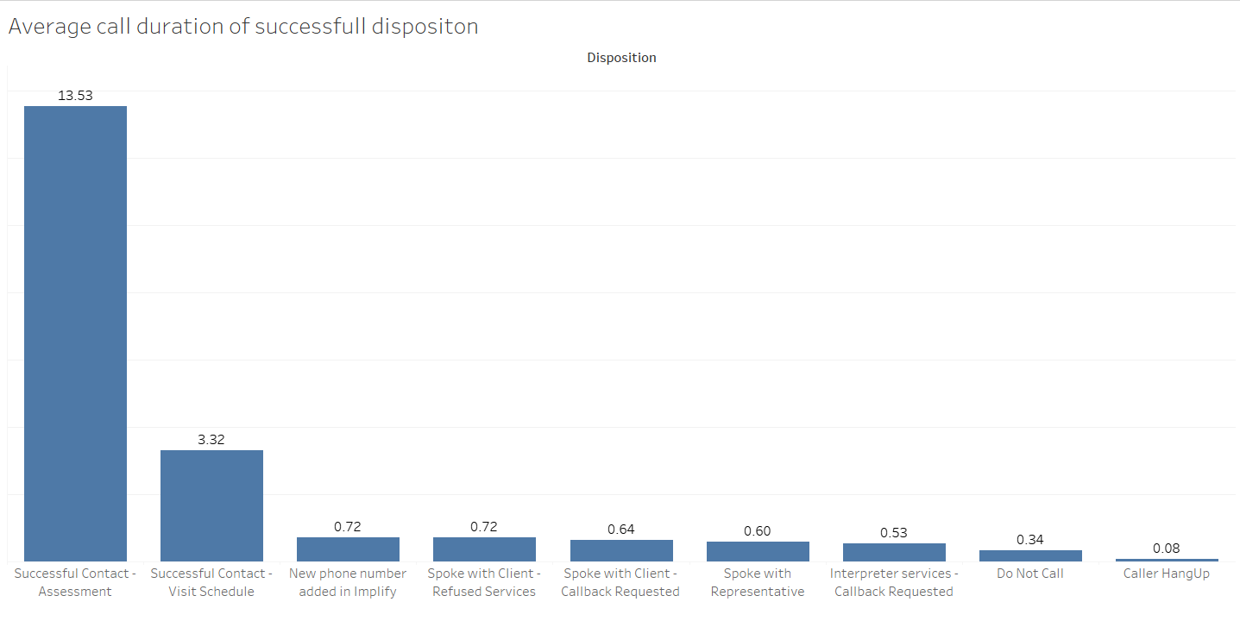
How long can we talk?
Notes:
Lets come up with a use case here where we convince that converting the UTC time to local time is very essential to take this data forward for building prediction models in the future.

Slide 7
Finally, What are we recommending?
Time zone: It is essential that we convert the UTC time zone in the dataset to local time zones to analyze the best contact time.
Preferred call time: Morning (9am to 11am) seems to be the best time to achieve successful call to convince the individuals to receive MCO.
States: CA and VA has the the highest hit rate.
Call duration: An average of 13 minutes looks to be a good duration for better engagement and understanding their needs. If we are able to engage the individuals to have a conversation longer, the chances of doing the lead conversion is also higher.
Gender: Females are most likely to be convinced.

